Slide 1
Shoulder arthroplasty
Solutions for Chronic Shoulder Pain
See the Instructions for Use for full prescribing information.
CAPD-0006-A

Slide 2

SHOULDER ARTHROPLASTY
SHOULDER ARTHROPLASTY
Data shows total shoulder arthroplasty (TSA) achieves 90-96% patient satisfaction with significant pain relief and functional improvement¹
At 6 weeks post-surgery, patients report 90% pain improvement from TSA¹
At 6 months post-surgery, patients report 96% functional recovery¹
10-year implant survival reports 94.6%¹
Estimated 174,000+ Americans will undergo a shoulder replacement procedure this year²
JSES Int. 2021 Apr 21;5(4):776–781. doi: 10.1016/j.jseint.2021.03.007
https://orthoinfo.aaos.org/en/treatment/shoulder-joint-replacement/

Slide 3
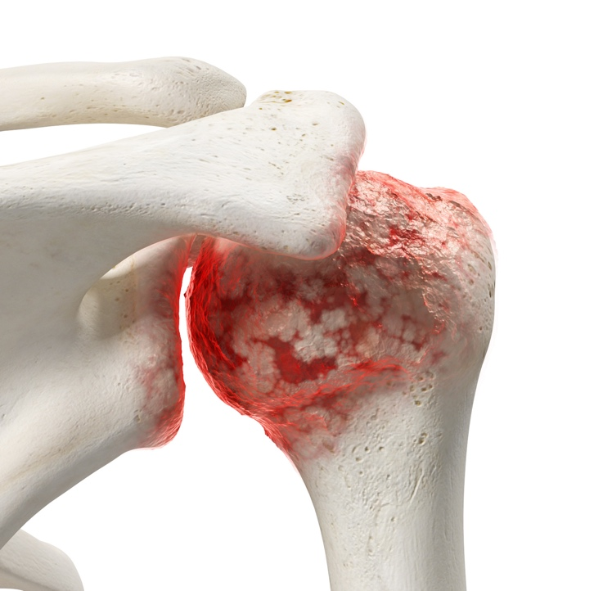
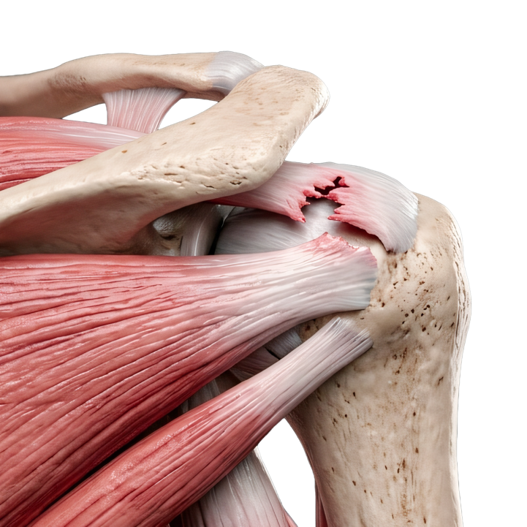
SHOULDER ARTHROPLASTY
CHRONIC SHOULDER PAIN SOURCES
Degenerative diseases:
  Osteoarthritis
  Rheumatoid arthritis
  Rotator cuff tear
  Necrosis
  Post-traumatic arthritis
Trauma:
  Fracture
ARTHRITIS
ROTATOR CUFF TEAR
ARTHROPATHY

Slide 4
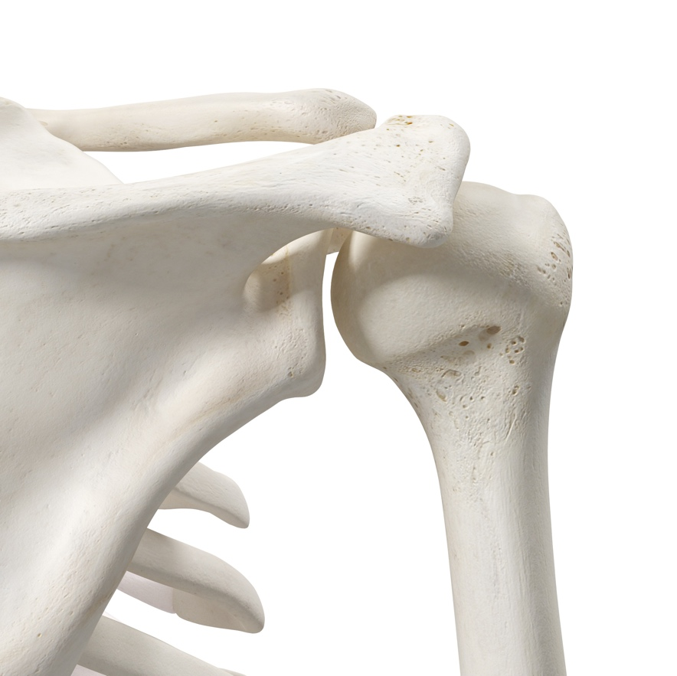
SHOULDER JOINT
SHOULDER ANATOMY
Greatest range of motion (ROM) of any joint in the body, enabling movements in multiple directions
Glenohumeral joint (ball-and-socket)
Rotator cuff
Healthy Shoulder
Healthy Rotator Cuff

Slide 5

CHRONIC SHOULDER PAIN
TREATMENT OPTIONS
Non-Surgical
  Lifestyle changes
  Physical therapy
  Medications
  Injections
Surgical (3 common types)
  Rotator cuff repair
  Shoulder arthroscopy
  Total shoulder replacement

Slide 6
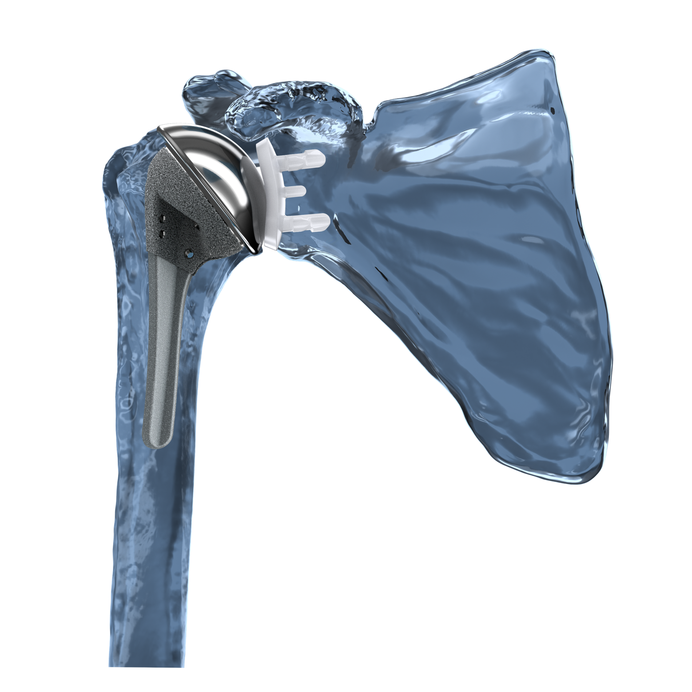
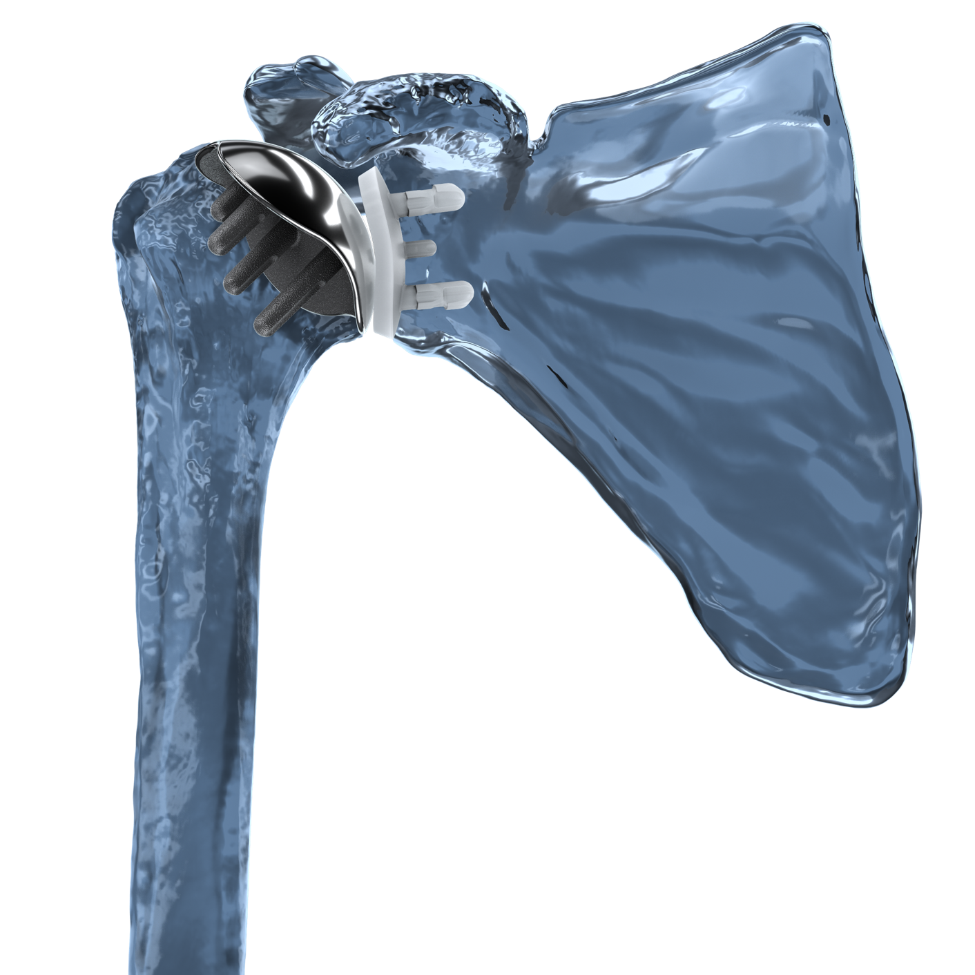
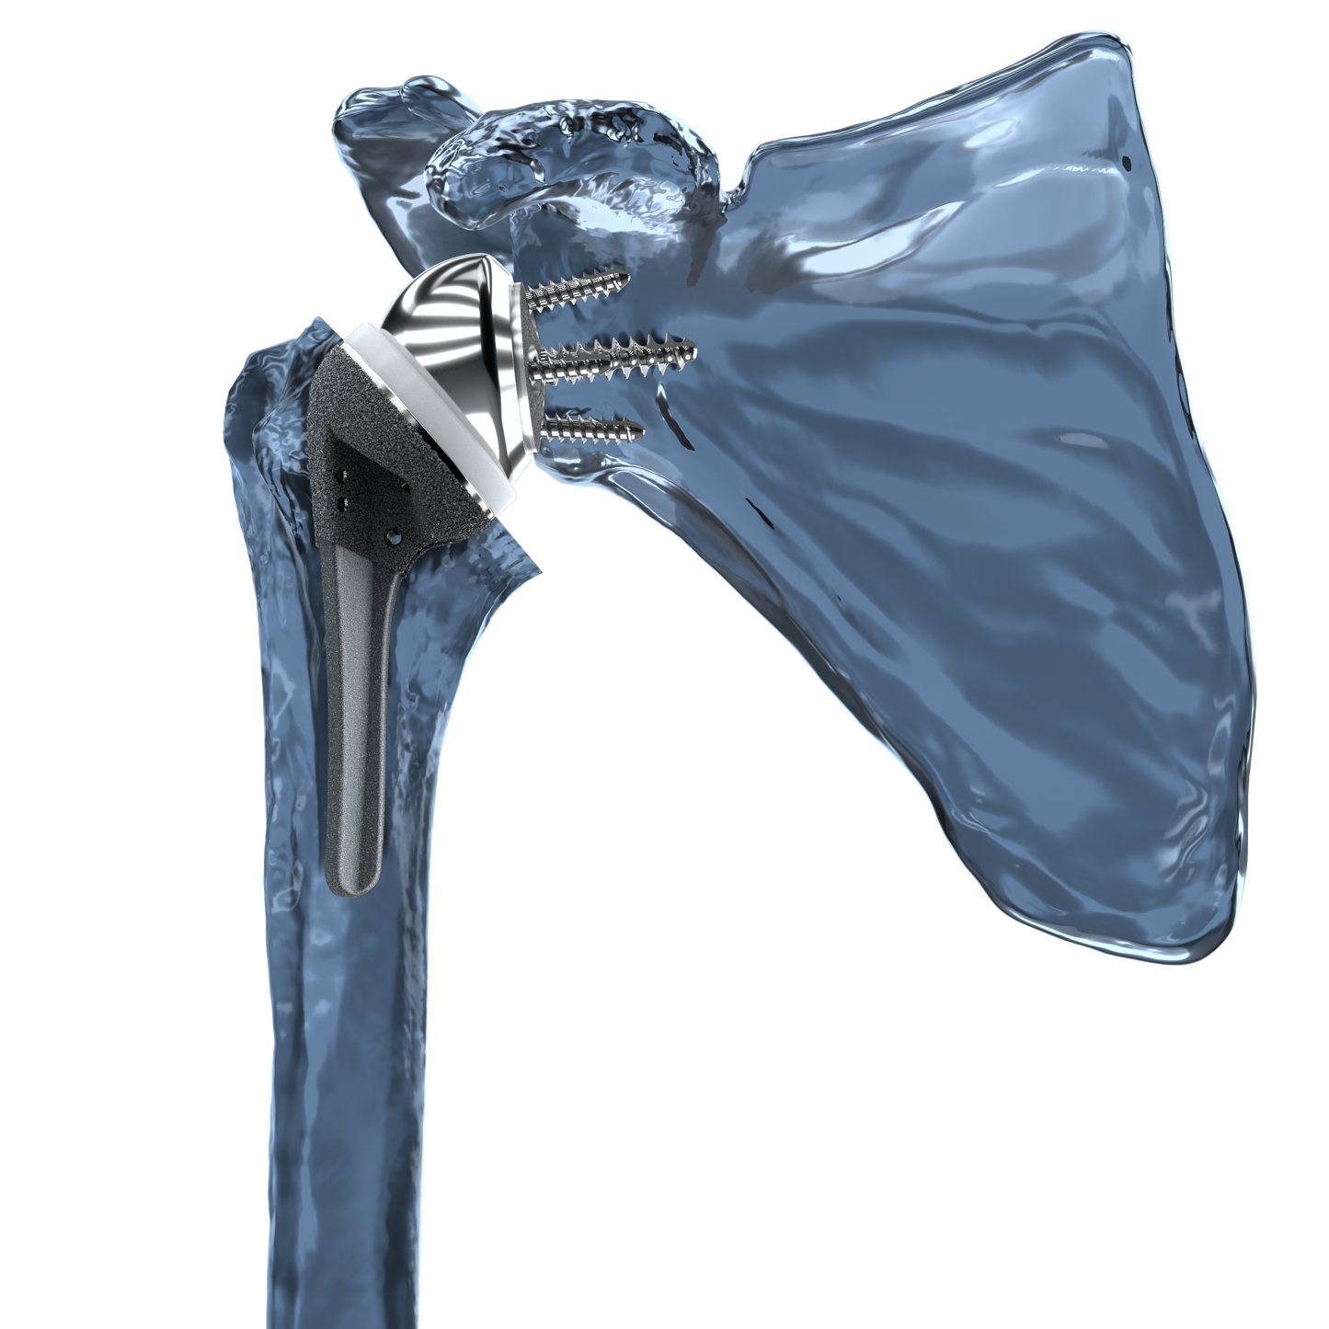
COMMON SHOULDER REPLACEMENT TYPES
STEMLESS ANATOMIC
STEMMED ANATOMIC
REVERSE

Slide 7
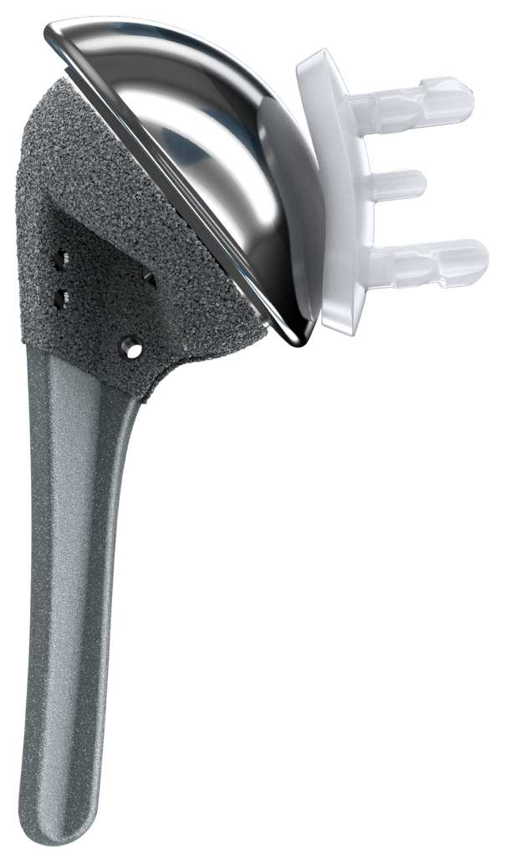
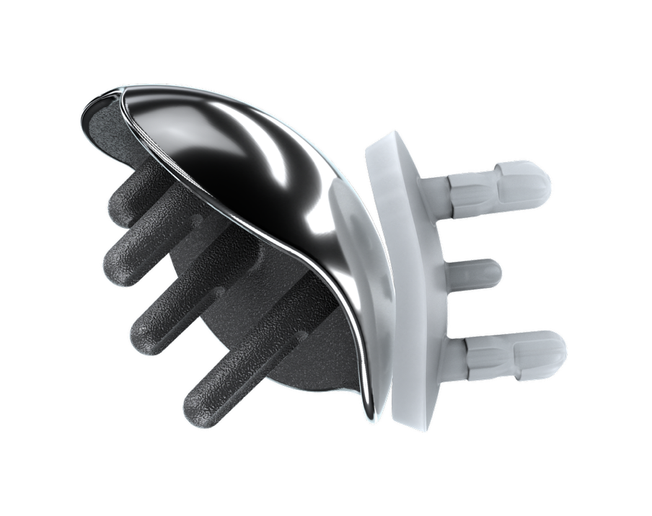
aTSA
ANATOMIC TOTAL SHOULDER ARTHROPLASTY
(ATSA)
Consists of humeral stem (stemless or stemmed), and glenoid
Usually performed after non-surgical treatment options have failed
Healthy rotator cuff is necessary for this procedure
Stemless Implant
+
Glenoid
Stemmed Implant
+
Glenoid

Slide 8
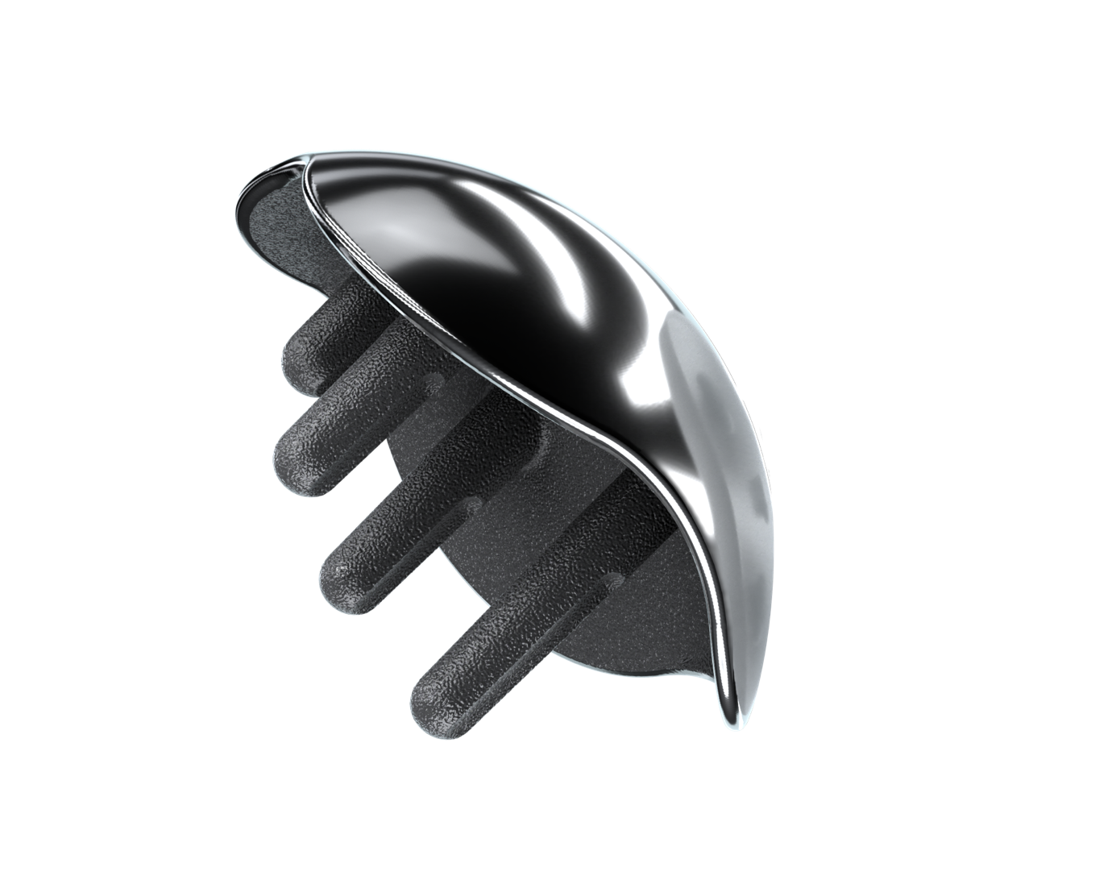
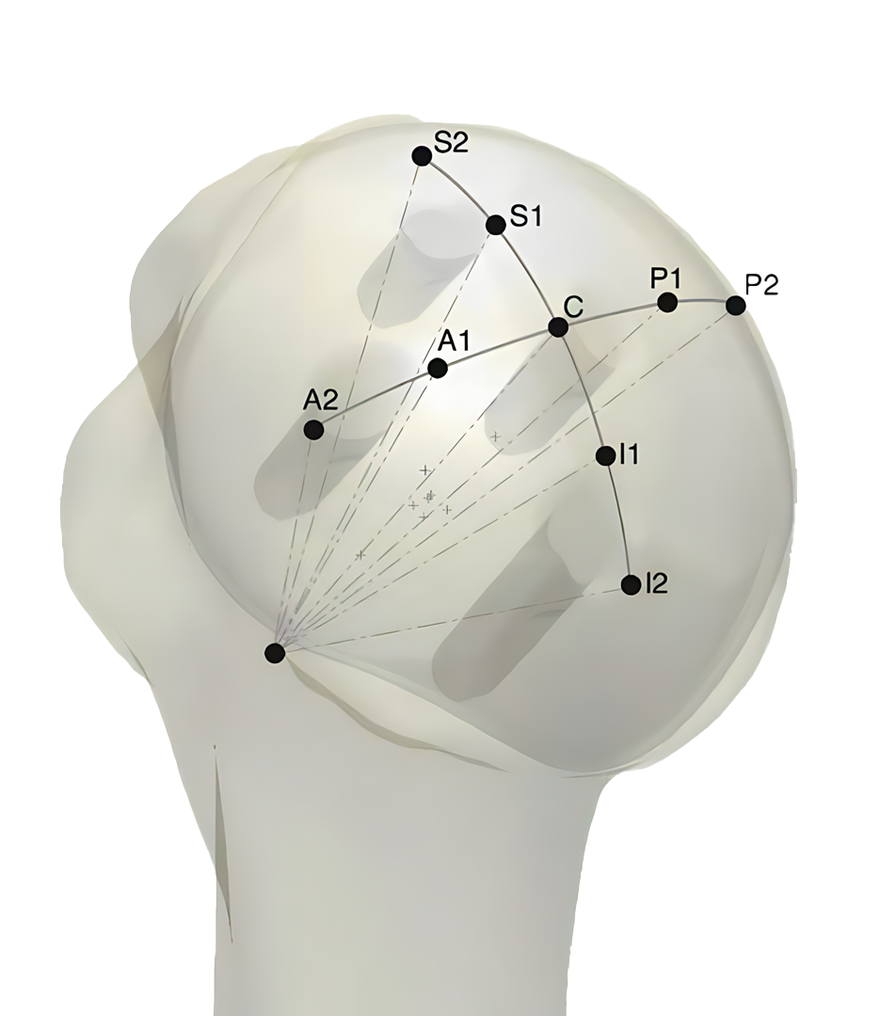
ANATOMIC HEAD DESIGN
Not all anatomic implants are the same. Some are specifically engineered to consistently restore the original size
and shape of the humerus
Anatomic = Natural Kinematics
Restoration of natural shape more accurately restores
the center of rotation and proper kinematics^{3,4}
Accurate anatomic reconstruction of the shoulder avoids abnormal physiological loads to the joint and the arthroplasty components^{5,6,7}
³ Jun et al. The effects of prosthetic humeral head shape on glenohumeral joint kinematics. JSES 2013; 22(10): 1423-32
⁴ Jun et al. The effect of prosthetic humeral head shape on glenohumeral joint kinematics during humeral axial rotation in TSA. JSES 2016; 25(7): 1084-93
⁵ Buchler P, Farron A. Benefits of an anatomical reconstruction of the humeral head during shoulder arthroplasty: a finite element analysis. Clin Biomech. Jan 2004; 19(1):16-23.
⁶ Harrold F, Wigderowitz C. Humeral head arthroplasty and its ability to restore original humeral head geometry. J Shoulder Elbow Surg. Jan 2013; 22(1):115-21.
⁷ Terrier A, Ramondetti S, Merlini F, Pioletti DD, Farron A. Biomechanical consequences of humeral component malpositioning after anatomical total shoulder arthroplasty. J Shoulder Elbow Surg. Dec 2010; 19(8): 1184-90.
Notes:
Ellipsoid shaped implant to match the true shape of the humerus.
Extremely accurate and able to reproduce center or rotation and head height within a mm.

Slide 9
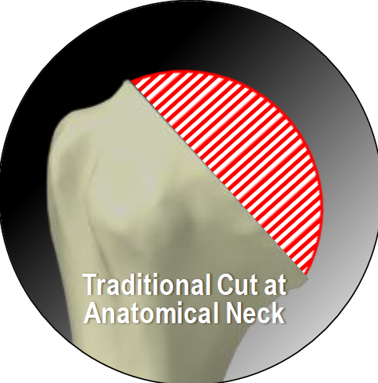
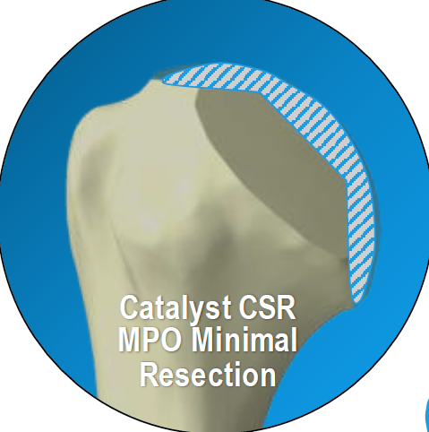
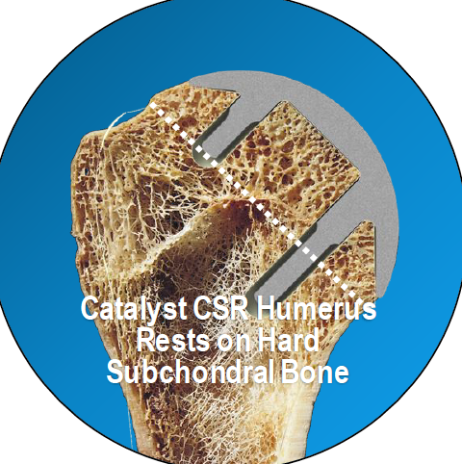
Bone preservation
Some anatomic implant designs spare more bone than others

Slide 10
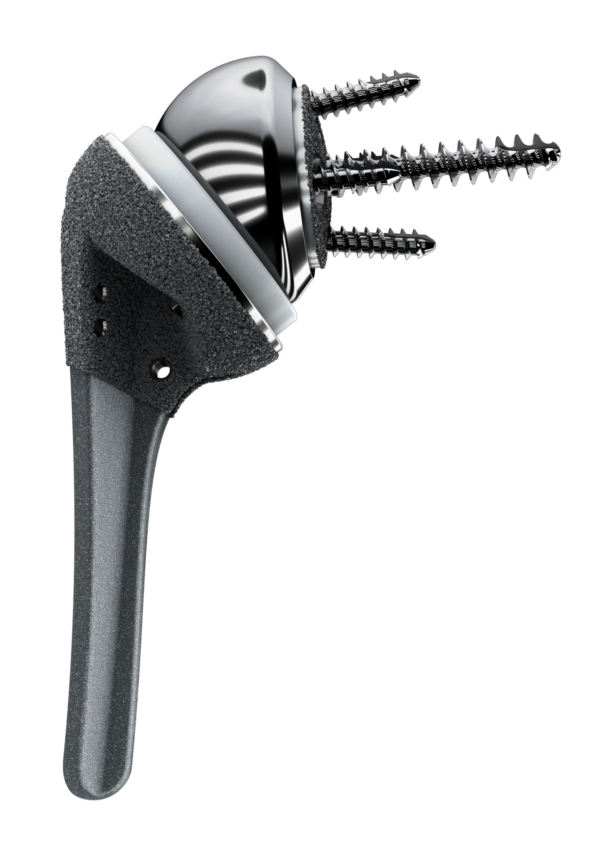
rTSA
REVERSE TOTAL SHOULDER ARTHROPLASTY
(RTSA)
Consists of reversed prosthesis that offers a “fixed fulcrum,” allowing arm to be raised when rotator cuff muscles are absent
Used for patients:
  With irreparable rotator cuff
  Arthritis
  Where it is impossible to lift arm
  Other complex shoulder issues and previously failed surgical treatments

Slide 11
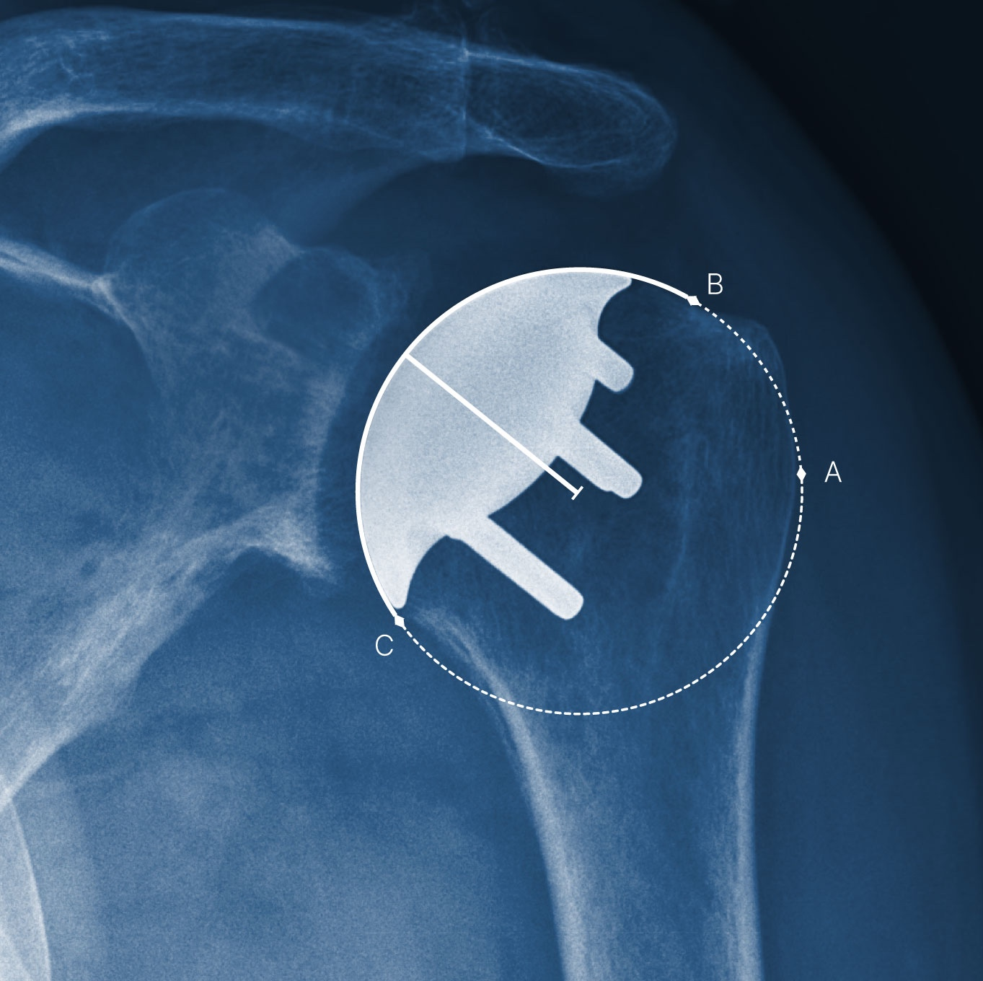
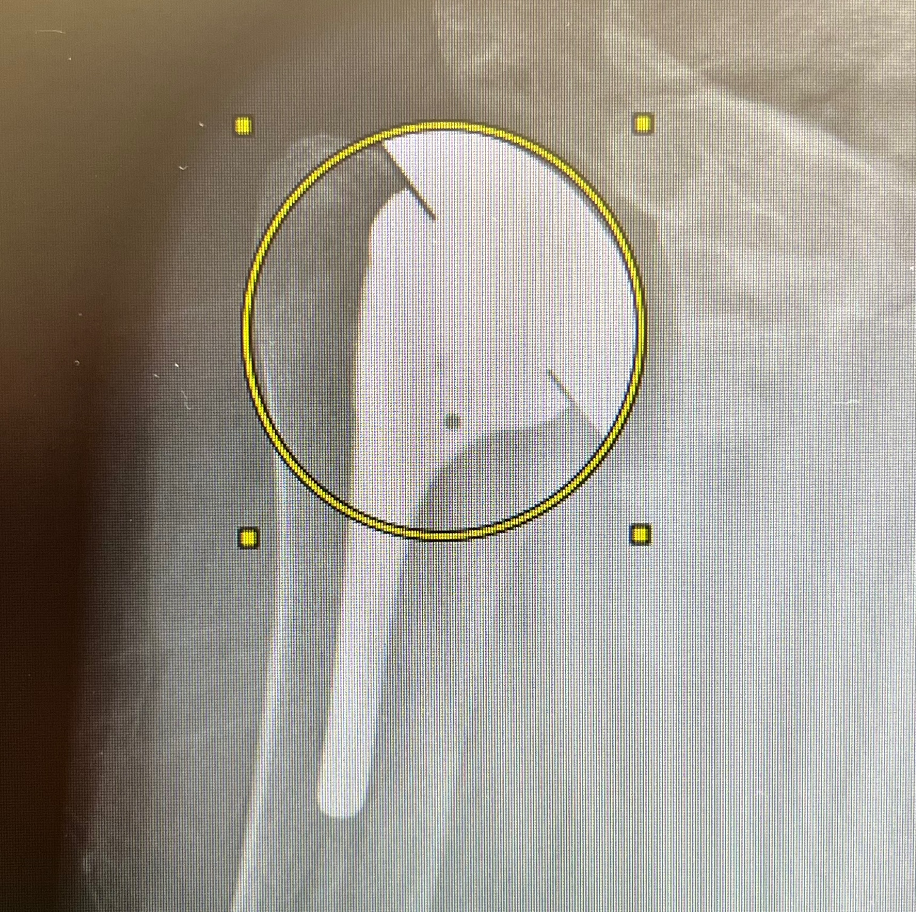
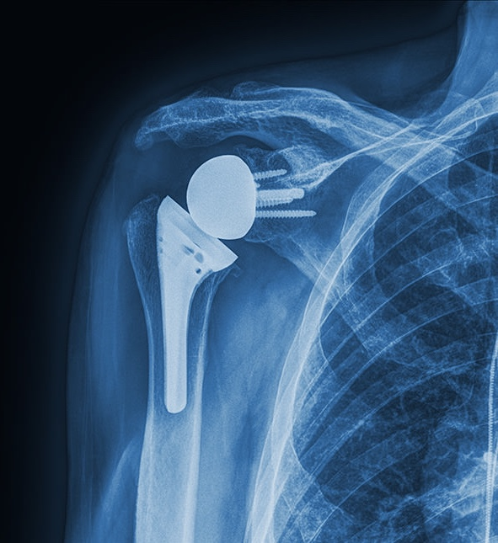
POST-OP RESULTS
STEMLESS ANATOMIC
STEMMED ANATOMIC
REVERSE

Slide 12
[aTSA/rTSA] CASE
PATIENT TESTIMONIAL
SUGGESTION: Invite a former patient to attend, share their experience and answer audience questions. As an alternative, add a video of a patient showing post-op results.
IMPORTANT: If you share a video, make sure to consider HIPAA and any other necessary facility approvals.

Slide 13

COMPLICATION CONSIDERATIONS
SHOULDER REPLACEMENT COMPLICATIONS ARE RARE, SOME OF THE MOST SEVERE ARE:
Infection
Dislocation
Postoperative fractures
Glenoid component failure
IMPORTANT: Patients considering shoulder replacement should talk
with their doctor about the benefits and risks before proceeding with
any treatment option.
Notes:
Design focused on restoring native shoulder function & surgical efficiency

Slide 14
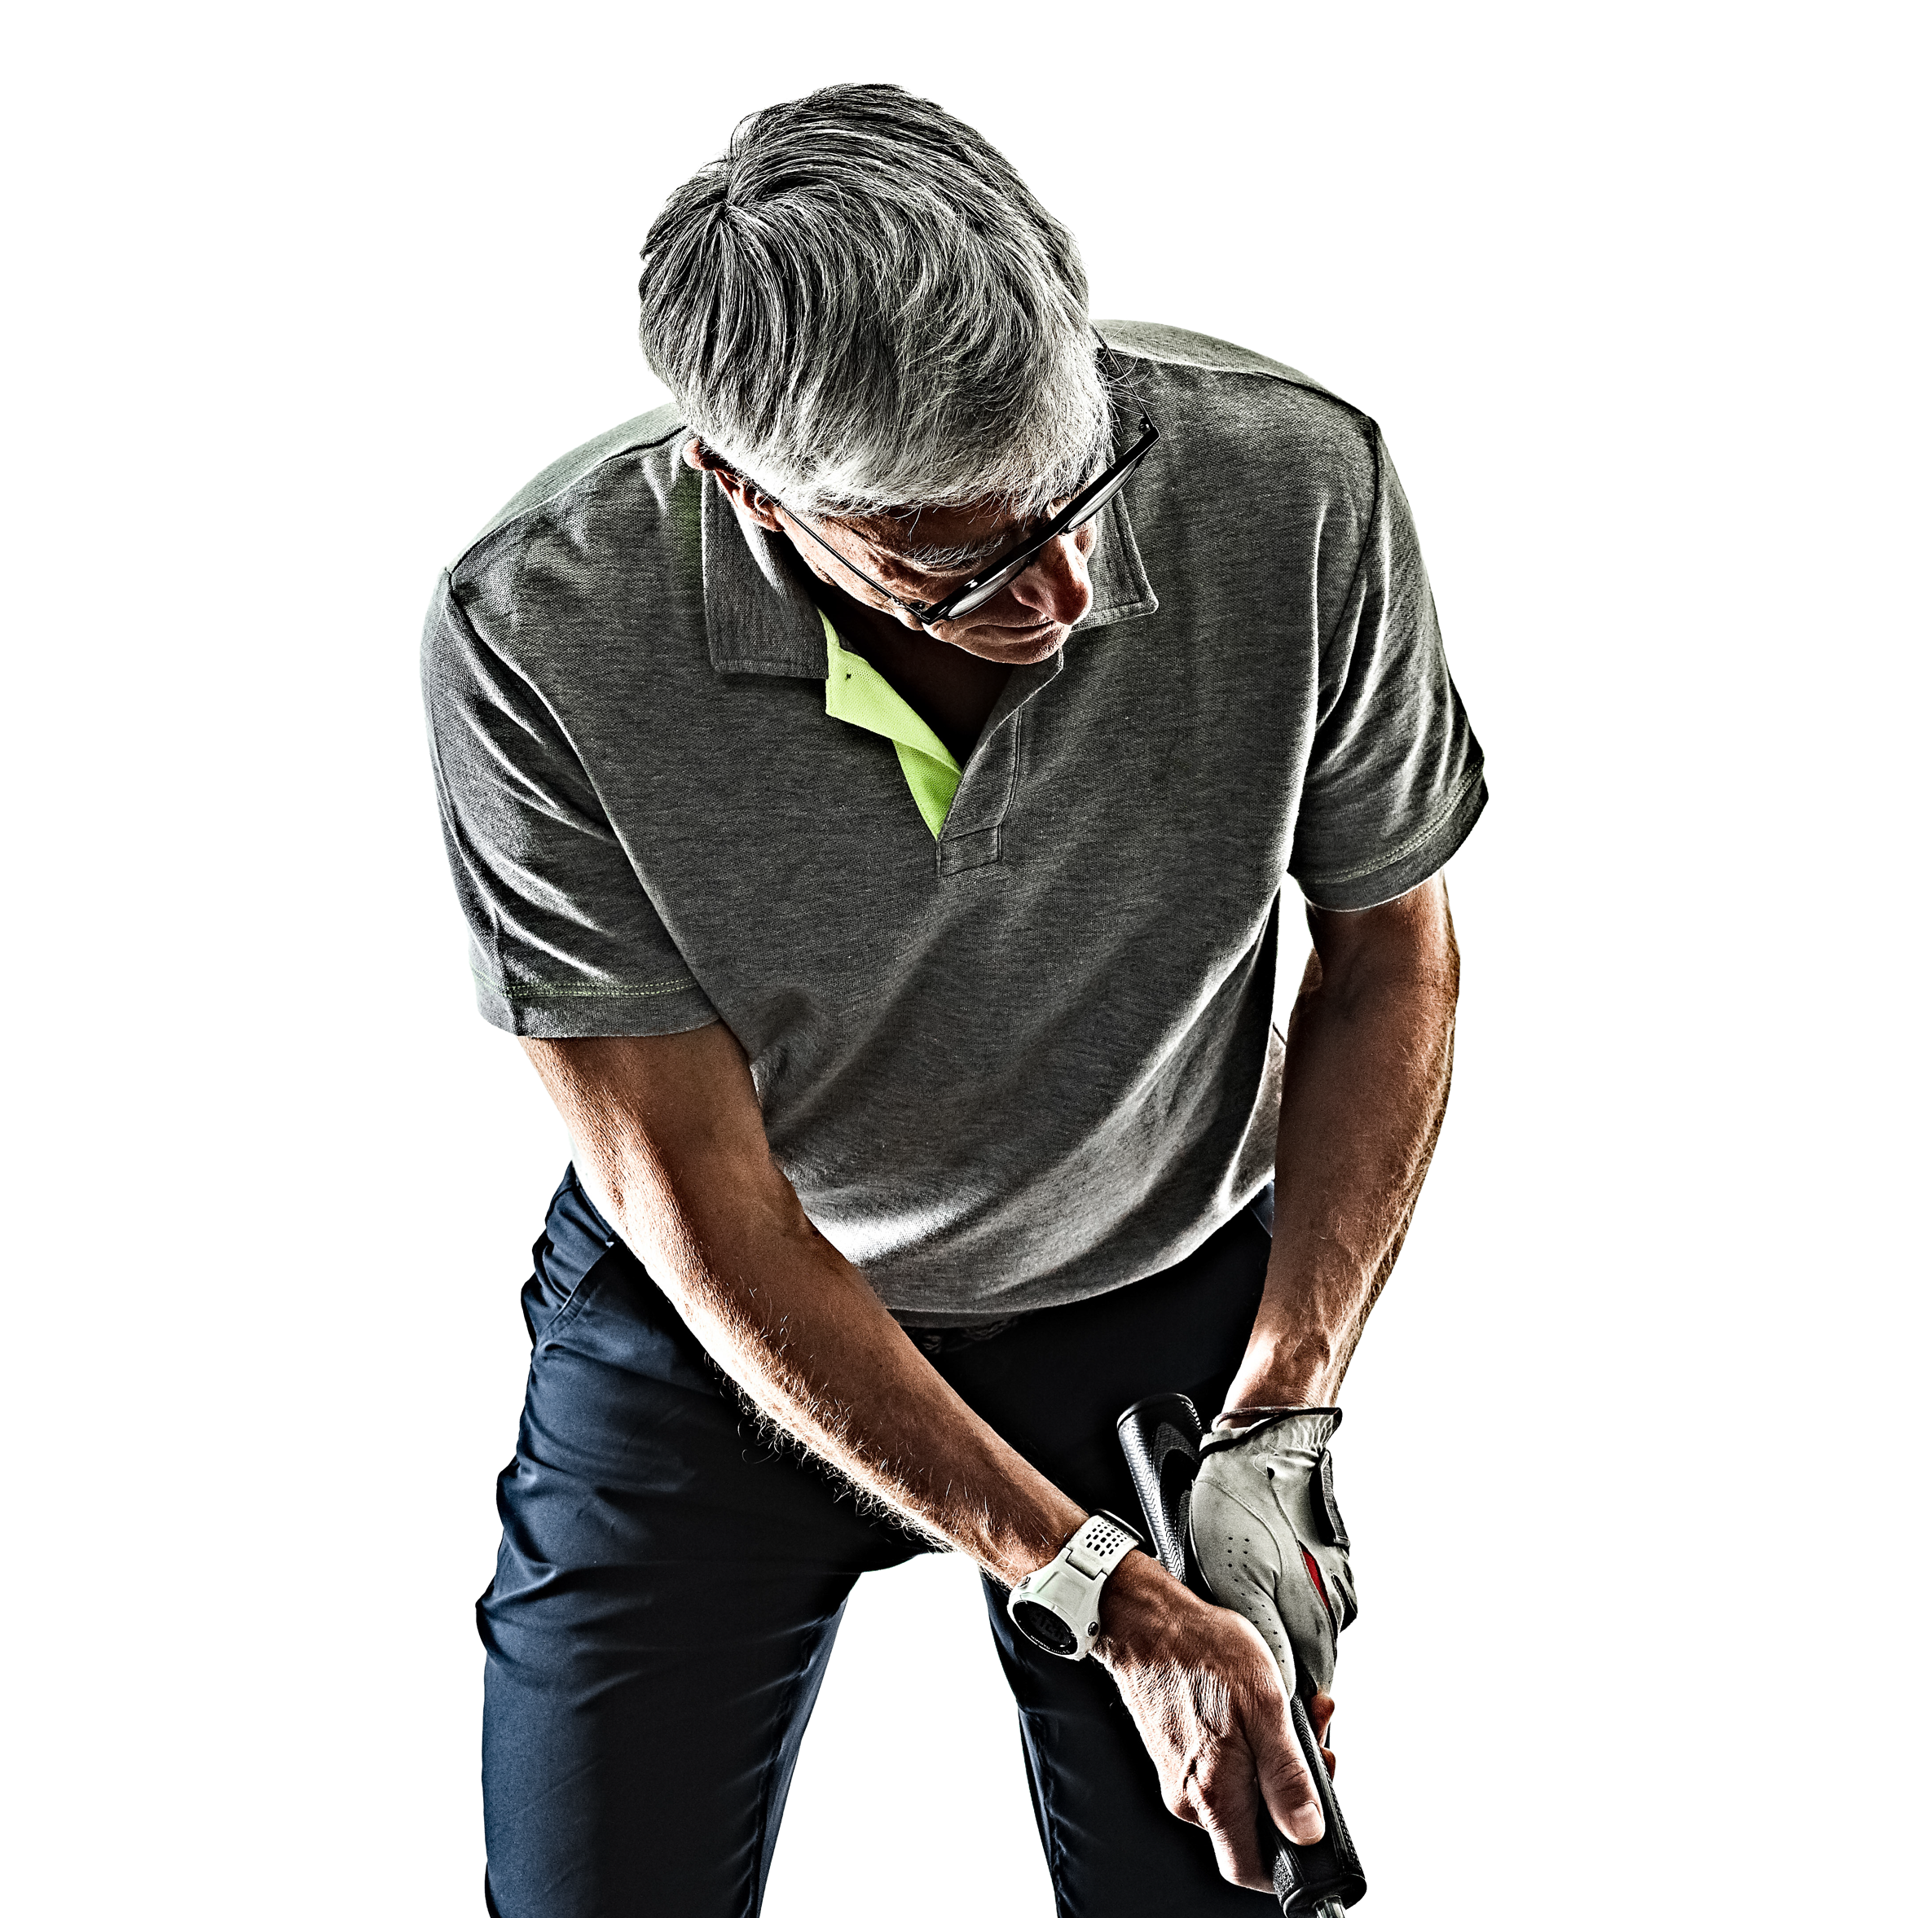
KEY SUCCESS FACTORS
KEY SUCCESS FACTORS
Condition and quality of the bone
Rotator cuff health
Type and severity of arthritis
Patient comorbidities
Age and activity level
Postoperative rehabilitation

Slide 15
PRACTICE INFORMATION
ABOUT [INSERT PRACTICE NAME]
Add information about your practice such as:
  # of shoulders performed
  Clinical results
  Case studies
  Website to learn more
  Appointment #
  Referral #:

